Slide 1
Walmart Sales Performance Analysis
SQL-Based Insights & Visual Findings

Slide 2
Top Branch by Sales Growth Rate
Branch | Avg growth percentage
B | -15.33
C | -17.69
A | -21.47

Slide 3
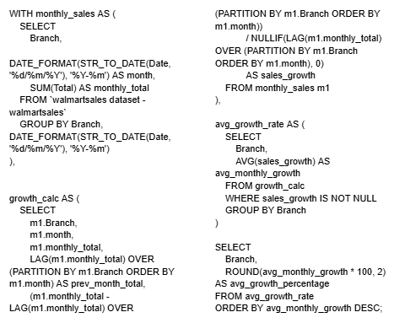

Slide 4
Most Profitable Product Line by Branch
Branch | Product line | Total profit
A | Health and beauty | -11398
B | Food and beverages | -13765.9
C | Home and lifestyle | -12572.2

Slide 5
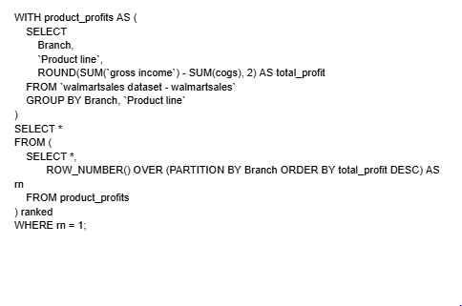

Slide 6
Customer Segmentation by Spending
Customer ID | Avg spending | Spending segment
8 | 397.53 | High
3 | 349.29 | High
2 | 349.14 | High
15 | 343.55 | High
1 | 337.83 | High
12 | 329.1 | Medium
11 | 324.22 | Medium
13 | 319.15 | Medium
14 | 318.93 | Medium
10 | 309.31 | Medium
6 | 308.87 | Low
7 | 307.88 | Low
9 | 293.46 | Low
5 | 293.02 | Low
4 | 263.53 | Low

Slide 7
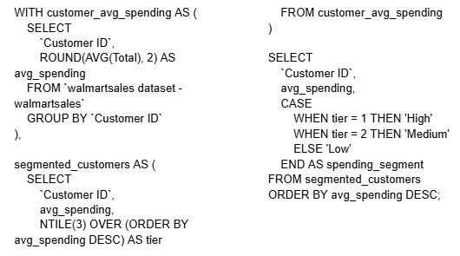

Slide 8
Detecting Sales Anomalies
Product line | Total | Avg total | Std total
Electronic accessories | 7753.337 | 2876.67 | 2206.98
Fashion accessories | 8230.908 | 2745.81 | 2185.92
Food and beverages | 10796.43 | 3872.04 | 2957.4
Health and beauty | 6240.528 | 2265.48 | 1657.32
Home and lifestyle | 5911.962 | 2019.84 | 1522.8
Sports and travel | 7385.196 | 2656.56 | 1981.04

Slide 9
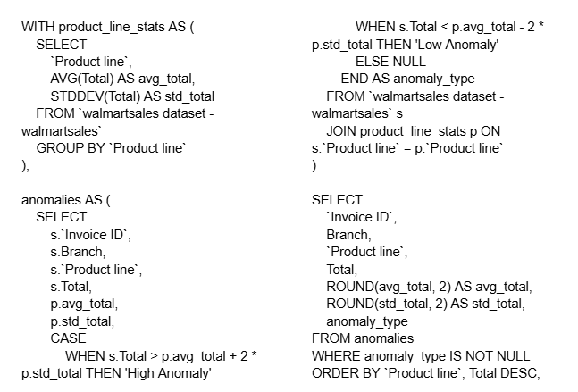

Slide 10
Most Popular Payment Method by City
City | Payment | payment count
Mandalay | Ewallet | 113
Naypyitaw | Cash | 124
Yangon | Ewallet | 126

Slide 11
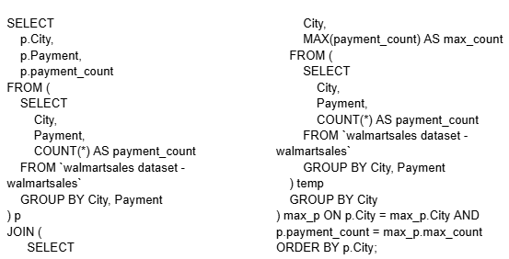

Slide 12
Monthly Sales Distribution by Gender
Sale month | Gender | Total sales
2019-01 | Female | 21912.22
2019-01 | Male | 17641.17
2019-02 | Female | 25082.85
2019-02 | Male | 21613.54
2019-03 | Female | 27698.12
2019-03 | Male | 21407.37

Slide 13
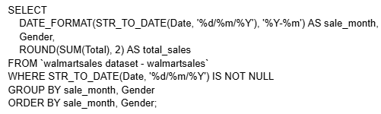

Slide 14
Best Product Line by Customer Type
Customer type | Product line | Purchase count
Member | Food and beverages | 94
Normal | Electronic accessories | 92
Normal | Fashion accessories | 92

Slide 15
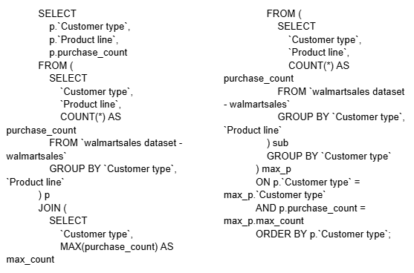

Slide 16
Identifying Repeat Customers
Customer ID | Repeat purchase count
12 | 367
1 | 349
9 | 332
5 | 249
6 | 248
13 | 219
7 | 218
8 | 213
10 | 192
2 | 177
15 | 164
14 | 144
4 | 136
3 | 122
11 | 106

Slide 17
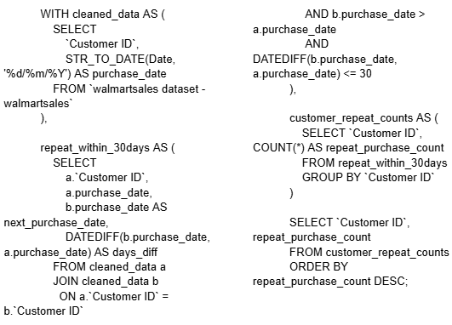

Slide 18
Top 5 Customers by Sales Volume
Customer ID | Total revenue
8 | 26634.34
3 | 23402.26
2 | 23392.28
15 | 22674.46
1 | 22634.55

Slide 19
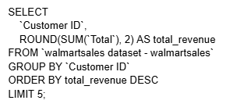

Slide 20
Sales Trends by Day of the Week
Day of week | Total sales
Sunday | 20239.56
Monday | 16671.58
Tuesday | 25977.46
Wednesday | 10964.87
Thursday | 14305.55
Friday | 17027.6
Saturday | 30168.64

Slide 21
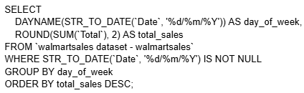

Slide 22
Record a video explaining the project
https://drive.google.com/file/d/1DyMpz-nDWMhAi_pmYL383ANKfhNIJg3G/view?usp=drivesdk

Slide 23
Thank You

